Slide 1

Object Oriented Programming
Creational Design Patterns: Prototype
IT560
Sourish Dasgupta
Assistant Professor, DA-IICT, Gandhinagar
https://daiict.ac.in/faculty/sourish-dasgupta

Slide 2
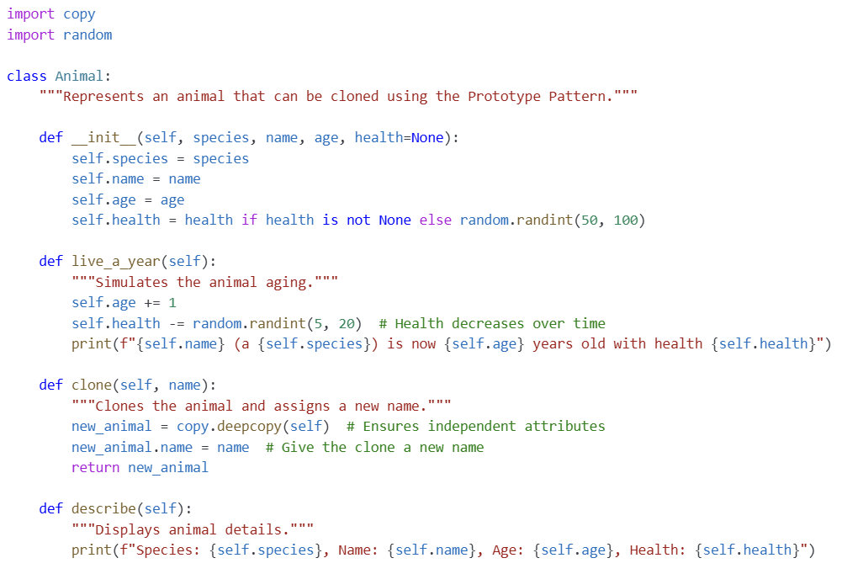
Prototype Design Pattern : Let’s clone from a template!
IT560: Creational Design Patterns: Prototype
Sourish Dasgupta

Slide 3
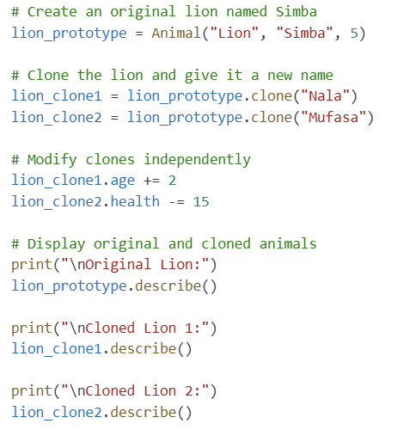
Prototype Design Pattern : Let’s not re-initialize common stuffs
🚀 Fast Object Creation – Instead of reinitializing animals with all their properties
🚀 Preserves Object State – A copied animal inherits attributes like age, species, health
🚀 Avoids Redundant Initialization – If many animals are similar (e.g., multiple lions with slight variations), cloning is more efficient
Only what is needed
IT560: Creational Design Patterns: Prototype
Sourish Dasgupta

Slide 4
Can we get a “manager” (zoo-keeper) instead?
(somewhat similar to Object Pool)
IT560: Creational Design Patterns: Prototype
Sourish Dasgupta

Slide 5
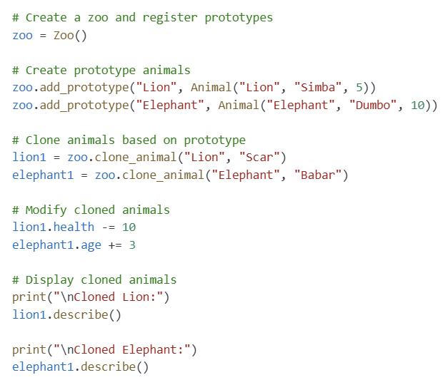
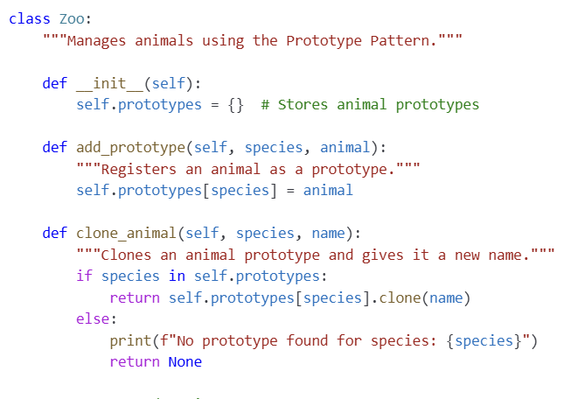
Prototype Design Pattern : Let’s create a prototype manager
IT560: Creational Design Patterns: Prototype
Sourish Dasgupta

Slide 6
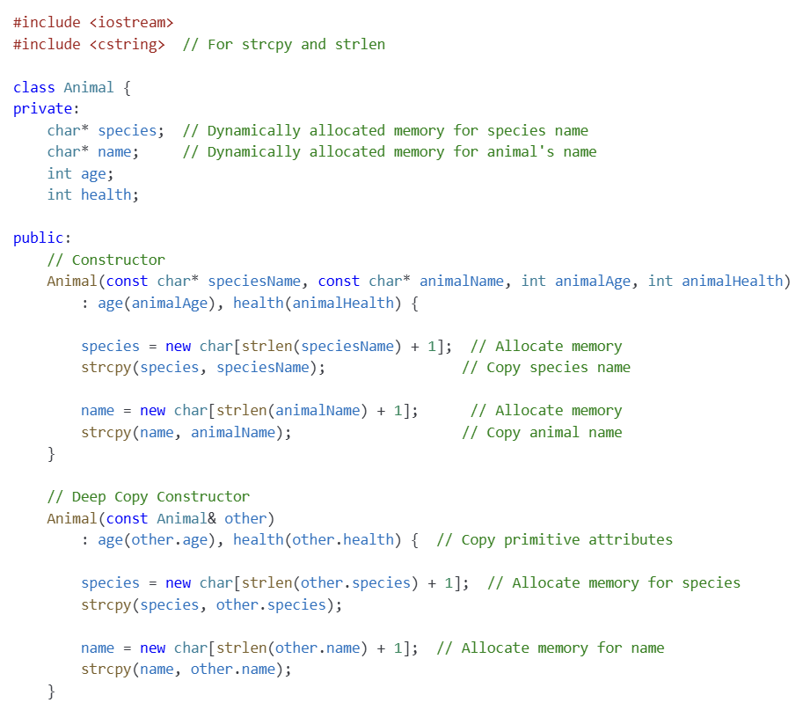
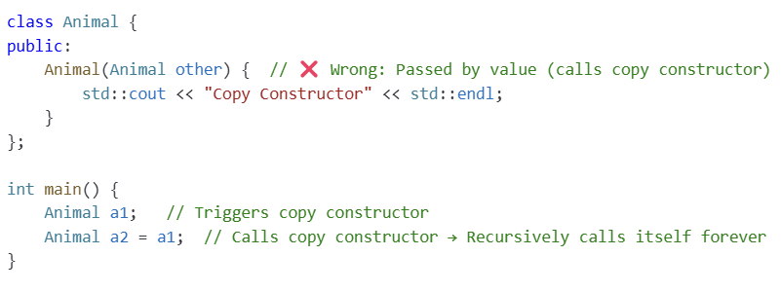
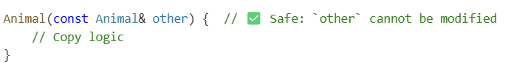
Prototype Design Pattern : Let’s clone with C++!
Direct initialization
BEWARE!!
IT560: Creational Design Patterns: Prototype
Sourish Dasgupta

Slide 7
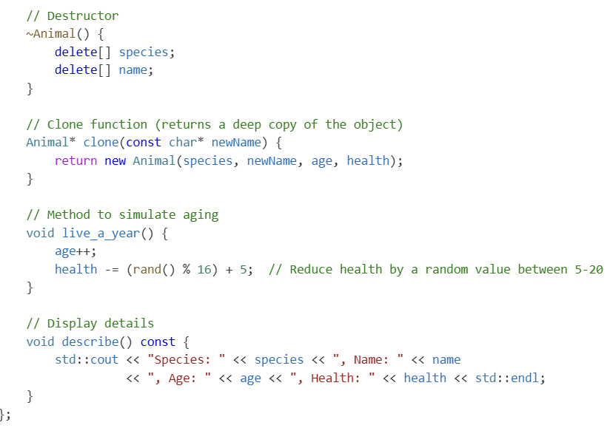
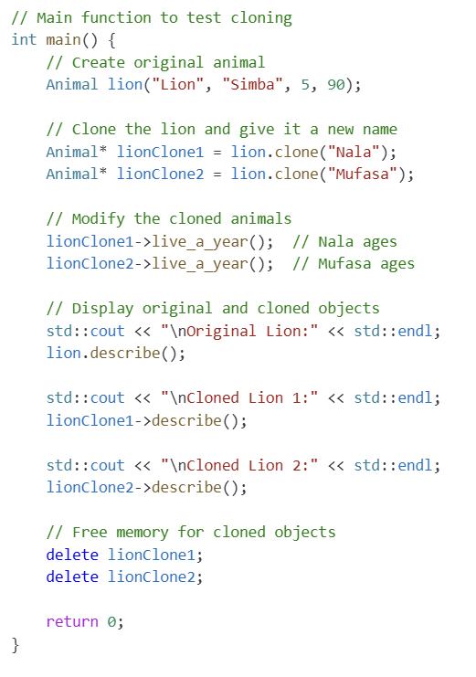
Prototype Design Pattern : Let’s clone with C++!
IT560: Creational Design Patterns: Prototype
Sourish Dasgupta

Slide 8
Prototype: Key Takeaways
Advantage | Descriptions
Fast Object Creation | Cloning is faster than re-initializing every attribute
Encapsulated Cloning Logic | Objects know how to clone themselves, keeping code clean
Independent Objects | Each cloned animal is a separate object in memory and can be modified independently NT: Does NOT automatically assign a new unique ID
Ideal for Large Systems | Useful in games, simulations, and automation where predefined templates are needed
IT560: Creational Design Patterns: Prototype
Sourish Dasgupta

Slide 9
Prototype: Regular vs Deep Constructors
Feature | Regular Constructor | Deep Copy Constructor
Purpose | Initializes a new object | Creates a copy of an existing object
Used When? | Animal a1("Lion", 5); | Animal a2 = a1;
Handles Dynamic Memory? | No | Yes (Allocates new memory)
Prevents Memory Issues? | No | Yes (Avoids shared pointers)
When Needed? | Always for new objects | Needed when objects have pointers
IT560: Creational Design Patterns: Prototype
Sourish Dasgupta

Slide 10
Prototype: Python vs C++
Feature | Python | C++
Memory Management | Handled automatically | Manual allocation (new) and deallocation (delete)
Cloning Method | Uses copy.deepcopy() | Uses a deep copy constructor and clone() function
String Storage | Uses Python str (immutable) | Uses dynamically allocated char*
Garbage Collection | Automatic | Needs explicit destructor
IT560: Creational Design Patterns: Prototype
Sourish Dasgupta

Slide 11
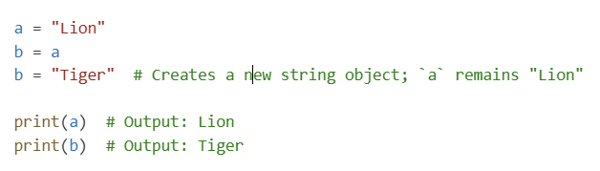
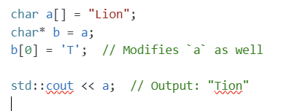
Prototype: Python vs C++
String Default: Immutable
String Default: Mutable
IT560: Creational Design Patterns: Prototype
Sourish Dasgupta

Slide 12
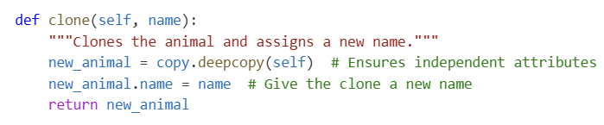
Prototype: Python vs C++
String Default: Immutable
species and name are immutable (str) → no need of deep copying.
IT560: Creational Design Patterns: Prototype
Sourish Dasgupta

Slide 13
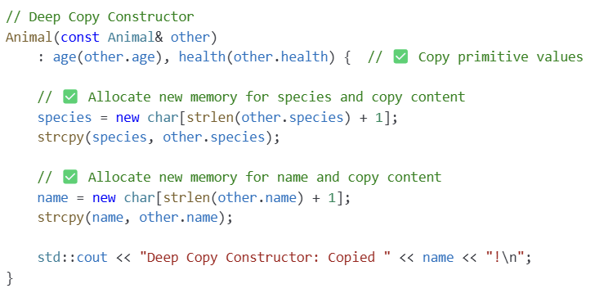
Prototype: Python vs C++
String Default: mutable
Explicit deep copy of char* to prevent memory issues.
IT560: Creational Design Patterns: Prototype
Sourish Dasgupta

Slide 14
Can cloning go haywire?
IT560: Creational Design Patterns: Prototype
Sourish Dasgupta

Slide 15
Prototype: When to avoid?
Criteria | Prototype is a BAD Choice When... | Why?
Objects Have Unique Identity | Each object has a unique ID, serial number, or real-world identity. | Cloning would create duplicate IDs, breaking identity uniqueness.
Objects Contain Constantly Changing Data | The object’s attributes (e.g., GPS, health status, timestamps) change frequently. | A cloned object copies outdated values, leading to inaccurate data.
Object Creation is Simple and Efficient | The object’s construction is cheap (e.g., primitive types, lightweight objects). | Creating a new object from scratch is more efficient than cloning.
IT560: Creational Design Patterns: Prototype
Sourish Dasgupta

Slide 16
Prototype: When to avoid?
Criteria | Prototype is a BAD Choice When... | Why?
Cloning Would Cause Logical Errors | Objects require strict uniqueness (e.g., wildlife tracking, transaction records). | Cloning creates misleading copies, making real-world tracking impossible.
Objects Have Complex Dependencies | Objects rely on external resources (e.g., database connections, network sockets). | Cloning would copy references, leading to shared state issues.
Object’s State Cannot Be Copied Reliably | Objects hold unique or non-copyable attributes (e.g., file handles, hardware locks). | Cloning such objects causes runtime errors or unintended side effects.
IT560: Creational Design Patterns: Prototype
Sourish Dasgupta

